Slide 1
Using RESTful web APIs with Fetch
Music API | Getting Songs| Adding New Songs | Updating songs | Deleting Songs
Notes:
Welcome to our lecture on how to use RESTful API to fetch data. In this lecture we will investigate a music API, explore how to add new song, how to update song, and how to delete song in database. Let’s start the video lecture.

Slide 2
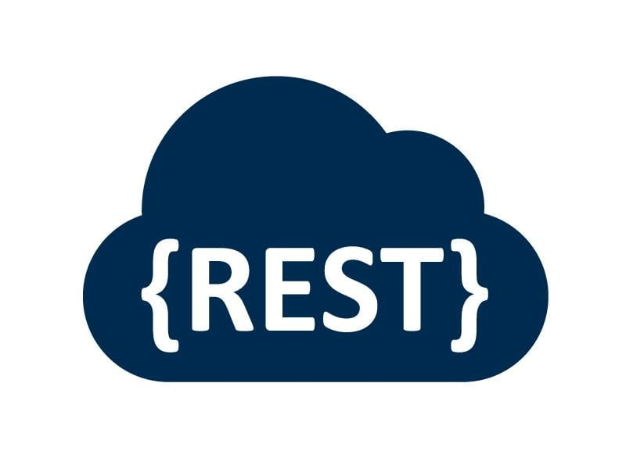
Music API
Web API manipulates database data on the server.
RESTful Music API manages song data.
Song resource includes specific fields for each song.
Notes:
In this section, we introduce the Music API, which is a web API designed to manipulate song data stored on a server. The RESTful Music API specifically manages song-related information, allowing for CRUD operations. Each song resource contains specific fields like title, artist, popularity, and genre, making it easier to manage song data.

Slide 3
Music API
The Music API uses a song resource with the following fields:
_id - Object ID uniquely identifying each song
title - Required string
artist - String
popularity - Number between 1 and 10
releaseDate - Date
genre - Array of strings
Notes:
The Music API uses a song resource with several fields that define each song. These include a unique identifier, the title, and the artist name. The popularity is a rating between 1 and 10, while the release date is stored as a date. Additionally, the genre field is an array of strings, allowing multiple genres to be associated with each song.

Slide 4
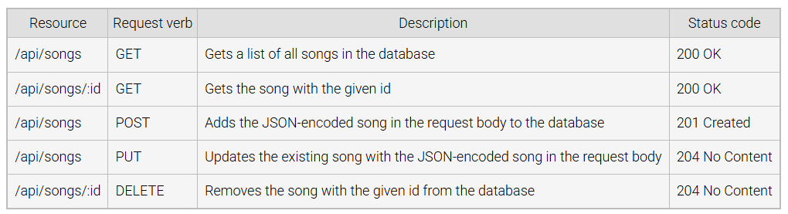
Example: Music API Operations
Notes:
This table shows common operations in the Music API. The GET request retrieves a list of all songs or a specific song by its ID. The POST request adds a new song to the database, while the PUT request updates an existing song. The DELETE request removes a song by its ID. Each operation returns an appropriate status code indicating success or failure.

Slide 5
Getting Songs
Web apps call APIs using XMLHttpRequest, Fetch, or other libraries.
Fetch API is used to interact with the Music API.
Music API runs on an Express server.
Song data is stored in a MongoDB database.
Notes:
Web applications interact with APIs using tools like XMLHttpRequest, Fetch, or other libraries. The Fetch API is commonly used to communicate with the Music API to get song data. The Music API itself runs on an Express server, while all song data is stored in a MongoDB database, ensuring organized and efficient data retrieval.

Slide 6
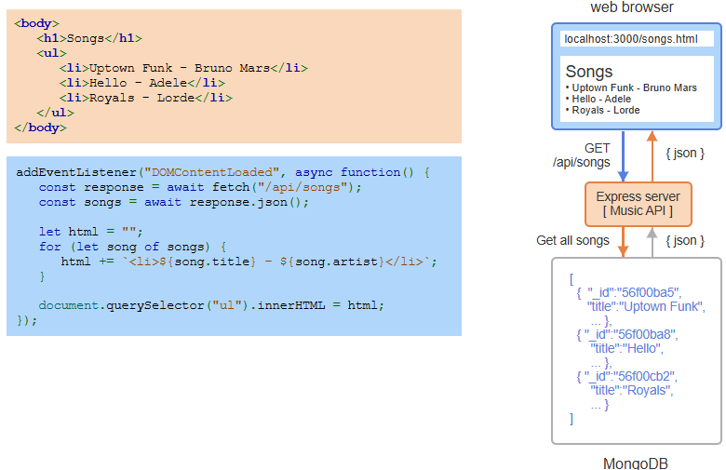
Example: Using Fetch to request all songs from the Music API.
Notes:
In this example, the web browser fetches all songs from the Music API using the Fetch API. When the page loads, it sends a GET request to retrieve the song data from the server. The songs are returned in JSON format and displayed on the webpage. Each song's title and artist are dynamically added to the HTML list, showing the results on the page.

Slide 7
Adding New Songs
fetch() sends a POST request with song data.
Request includes method, headers, and JSON body.
Form submission triggers POST to the Music API.
Notes:
To add new songs, we use the fetch function to send a POST request to the Music API with song data. The request includes the method, headers, and the song data in the JSON format in the body. This process is typically triggered by submitting a form, allowing users to add new songs to the database.

Slide 8
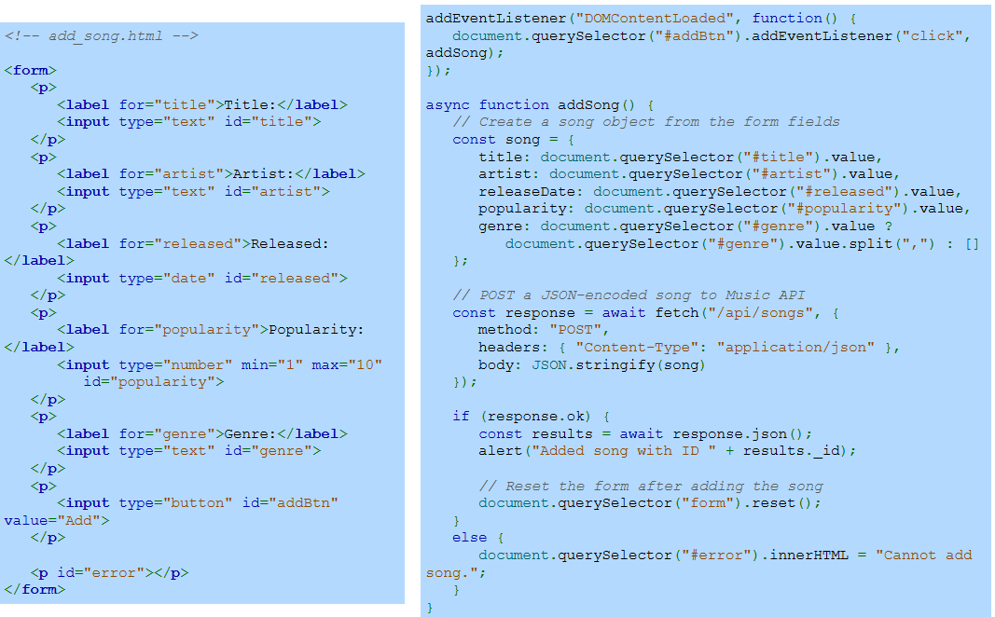
Example: Posting A New Song
Notes:
In this example, a form is used to collect song information such as title, artist, release date, popularity, and genre. When the form is submitted, the data is used to create a song object. This object is then sent to the Music API through a POST request, adding the song to the database. If successful, the form is reset; otherwise, an error message is displayed.

Slide 9
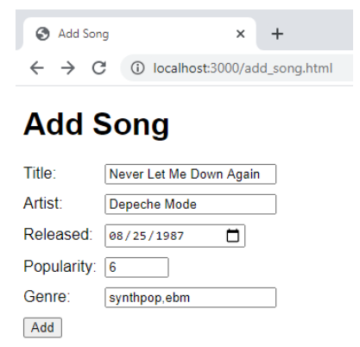
Example: Posting A New Song (Continue)
Notes:
In this continuation, we see the form filled out with song details such as the title, artist, release date, popularity, and genre. Once the user clicks the "Add" button, the data is sent to the Music API to add the song to the database. The form allows for easy addition of new songs with all the required information.

Slide 10
Updating Songs
fetch() loads a song into a web form on page load.
User edits the song data in the form.
Update button triggers a PUT request to update the song.
Notes:
In this process, the fetch function loads the song data into a web form when the page loads. The user can then edit the song details in the form. After making the necessary changes, the update button triggers a PUT request to send the updated song data to the server, ensuring the song information is updated in the database.

Slide 11
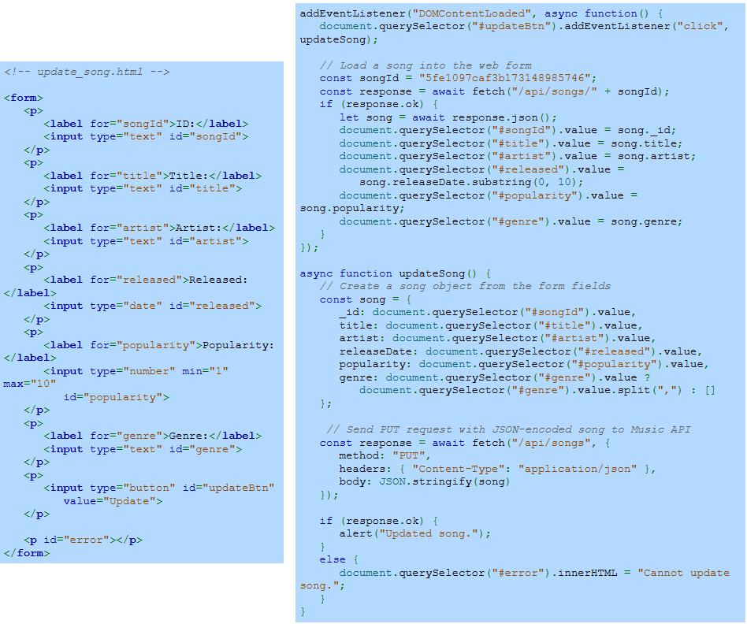
Example: Updating a Song
Notes:
In this example, a web form is used to update a song's details. When the page loads, the song data is fetched and displayed in the form fields. The user can edit the title, artist, release date, popularity, and genre. After making changes, the update button triggers a PUT request to update the song in the database with the new information.

Slide 12
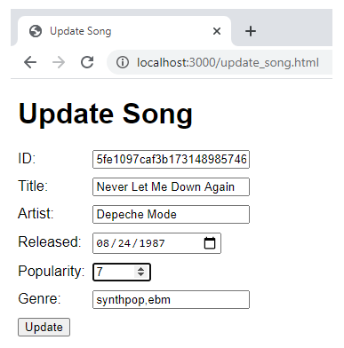
Example: Updating a Song (Continue)
Notes:
In this continuation, we see the web form populated with existing song details, such as the title, artist, release date, popularity, and genre. The user can edit the song information and then click the update button to trigger the PUT request. This action sends the updated song data to the server, updating the song in the database.

Slide 13
Deleting A Song
getAllSongs() loads song titles into a drop-down list.
User selects a song and clicks Delete.
deleteSong() sends a DELETE request to remove the song.
Notes:
To delete a song, the system first loads all song titles into a drop-down list. The user selects the song they wish to remove and clicks the "Delete" button. This action triggers a DELETE request, which sends a request to the server to remove the selected song from the database, ensuring the song is no longer listed.

Slide 14
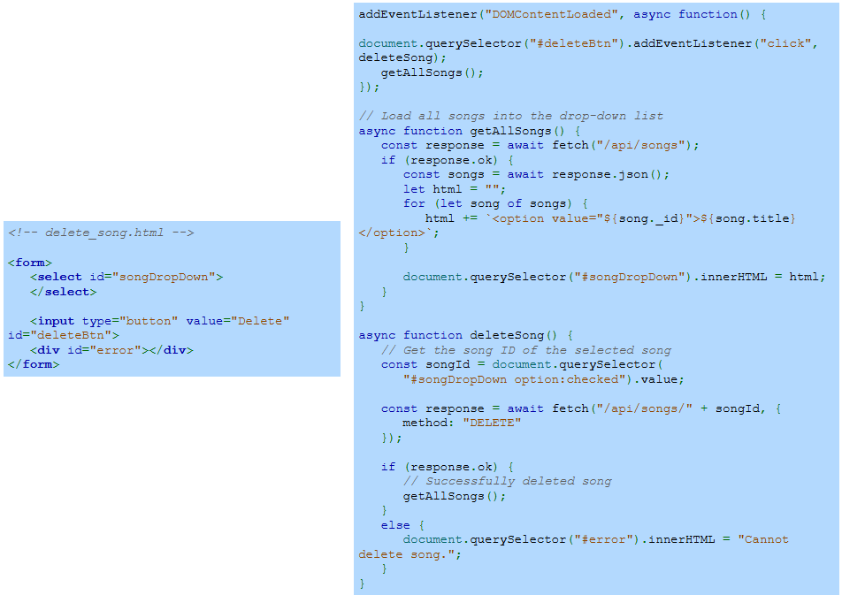
Example
Notes:
In this example, the web form allows the user to select a song from a drop-down list. When the page loads, all available songs are fetched from the server and displayed in the list. After the user selects a song and clicks the delete button, the selected song’s ID is sent in a DELETE request to the server, removing it from the database. If successful, the list is updated; otherwise, an error message is displayed.

Slide 15
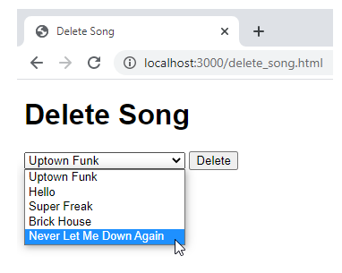
Example
Notes:
In this example, the user is presented with a drop-down menu that lists all available songs. The user can select the song they wish to delete, in this case, "Never Let Me Down Again." After selecting the song, the user can click the delete button to remove the song from the database. This interaction triggers the corresponding DELETE request to the server. Thanks for watching the lecture.

